Slide 1
Tutorial 9 Hiring and retention

Slide 2

Mid-Semester Exam QUESTION 2(b)
If the action and drama subscriptions can optionally be purchased in a bundle, what are the optimal prices of each of the action subscription, drama subscription and bundle?
Prices | Sales of A | Sales of D | Sales of B | Revenue | Profit
P_{B} = 900, PA≥700, P_{D}≥800 | 0 | 0 | 4 | $3600 | $3600
P_{B} = 1300, P_{A}=700, P_{D}=800 | 1 | 1 | 2 | $4100 | $4100
P_{B} = 1400, P_{A}=700, P_{D=}800 | 1 | 2 | 1 | $3700 | $3700

Slide 3
Mid-Semester Exam QUESTION 2(b)
If the action and drama subscriptions can optionally be purchased in a bundle, what are the optimal prices of each of the action subscription, drama subscription and bundle?
Prices | Sales of A | Sales of D | Sales of B | Revenue | Profit
P_{B} = 900, PA≥700, P_{D}≥800 | 0 | 0 | 4 | $3600 | $3600
P_{B} = 1300, P_{A}=700, P_{D}=800 | 1 | 1 | 2 | $4100 | $4100
P_{B} = 1400, P_{A}=700, P_{D=}800 | 1 | 2 | 1 | $3700 | $3700

Slide 4
Mid-Semester Exam QUESTION 2(b)
If the action and drama subscriptions can optionally be purchased in a bundle, what are the optimal prices of each of the action subscription, drama subscription and bundle?
Prices | Sales of A | Sales of D | Sales of B | Revenue | Profit
P_{B} = 900, PA≥700, P_{D}≥800 | 0 | 0 | 4 | $3600 | $3600
P_{B} = 1300, P_{A}=700, P_{D}=800 | 1 | 1 | 2 | $4100 | $4100
P_{B} = 1400, P_{A}=700, P_{D=}800 | 1 | 2 | 1 | $3700 | $3700

Slide 5
Question 1
What is meant by the term efficiency wage? Why would a firm pay an efficiency wage? How might promotions tournaments or seniority rules also resolve incentive problems faced by firms?

Slide 6
Question 1
What is meant by the term efficiency wage? Why would a firm pay an efficiency wage?
Efficiency wages are wage premiums paid to reduce shirking because employees are afraid that if they are caught, they will be fired and lose this premium. Efficiency wages are also paid to discourage employee turnover.
Rationale:
suppose effort is costly to monitor
to induce effort, offer high wages
combine with light or probabilistic monitoring
and threaten termination for poor effort
with above-market wages, workers are motivated to work hard to avoid termination

Slide 7
Question 1
How might promotions tournaments resolve incentive problems faced by firms?
Promotion tournaments have the following characteristics:
Winner is uncertain.
The winner takes all.
Promotion is based on relative performance rather than absolute measure.
Encourages effort by linking promotion to effort.
Potential drawbacks include that relative performance evaluation can reduce cooperation.

Slide 8
Question 1
How might seniority rules resolve incentive problems faced by firms?
At the initial point of hiring a firm pays the worker less than their value of marginal product. Eventually, as you get more senior your wage increases and it will eventually exceed your value of marginal product.
This encourages sorting in that only individuals who will stick around and put in effort will accept such an offer - a 'slacker' will get fired while their pay is less than the value of their marginal product. For workers who take a job with this pay structure they are more likely to make firm specific investments knowing they will get rewarded at the firm with higher wages in the future.
Such an approach has some disadvantages. There must be trust between workers and firms (workers must trust the firm not to fire them before they get too senior and get a higher wage). There might be a need for mandatory retirement rules and for a FILO ('first in last out) rule that says the first person hired is the last person let go if there is a downturn.

Slide 9
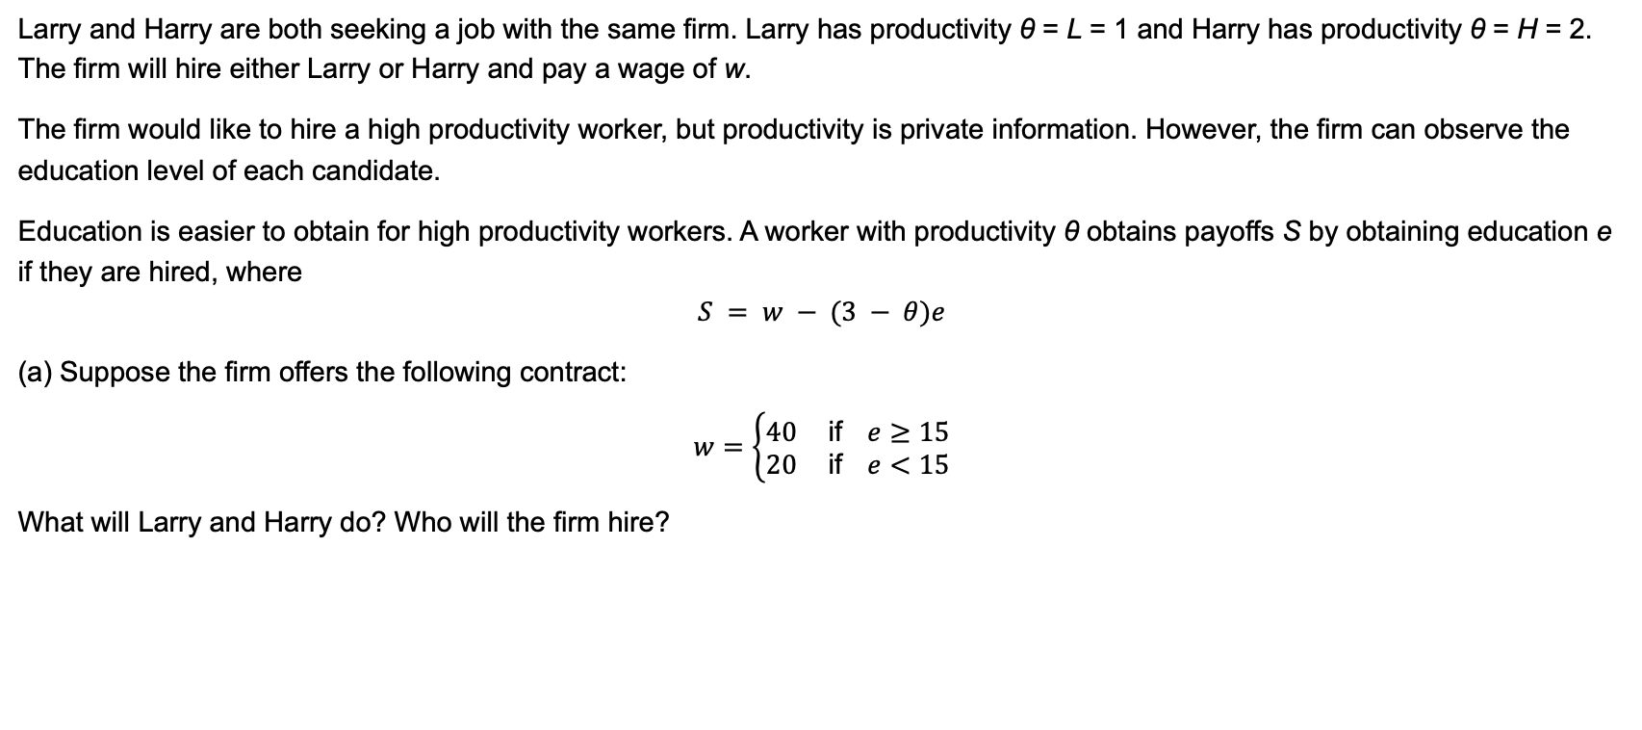
Question 2
Larry and Harry are both seeking a job with the same firm. Larry has productivity θ = L = 1 and Harry has productivity θ = H = 2. The firm will hire either Larry or Harry and pay a wage of w.
The firm would like to hire a high productivity worker, but productivity is private information. However, the firm can observe the education level of each candidate.
Education is easier to obtain for high productivity workers. A worker with productivity θ obtains payoffs S by obtaining education e if they are hired, where
$$S = w − (3 − θ)e$$
(a) Suppose the firm offers the following contract:
$$w=\left\{\begin{matrix}40 \text{if} e≥15 \\ 20 \text{if} e<15\end{matrix}\right.$$
What will Larry and Harry do? Who will the firm hire?

Slide 10
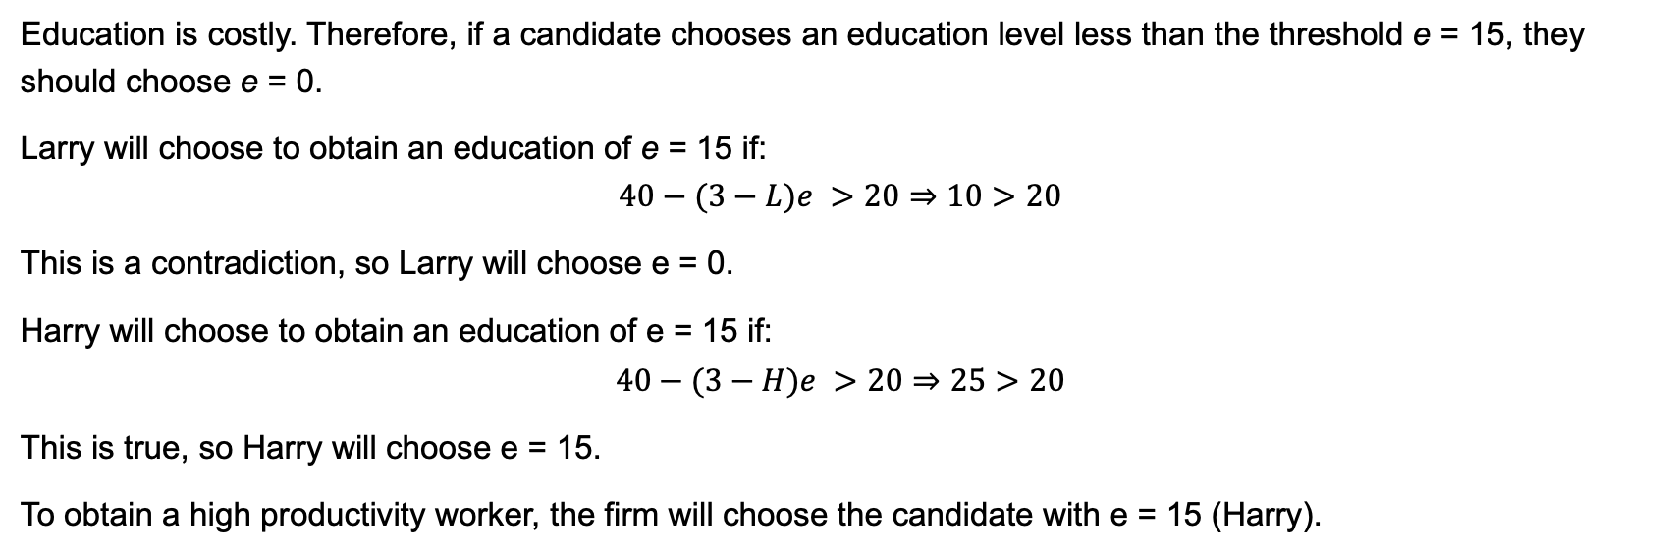
Question 2
Education is costly. Therefore, if a candidate chooses an education level less than the threshold e = 15, they should choose e = 0.
Larry will choose to obtain an education of e = 15 if:
$$40−(3−L)e >20⇒10>20$$
This is a contradiction, so Larry will choose e = 0.
Harry will choose to obtain an education of e = 15 if:
$$40−(3−H)e >20⇒25>20$$
This is true, so Harry will choose e = 15.
To obtain a high productivity worker, the firm will choose the candidate with e = 15 (Harry).

Slide 11
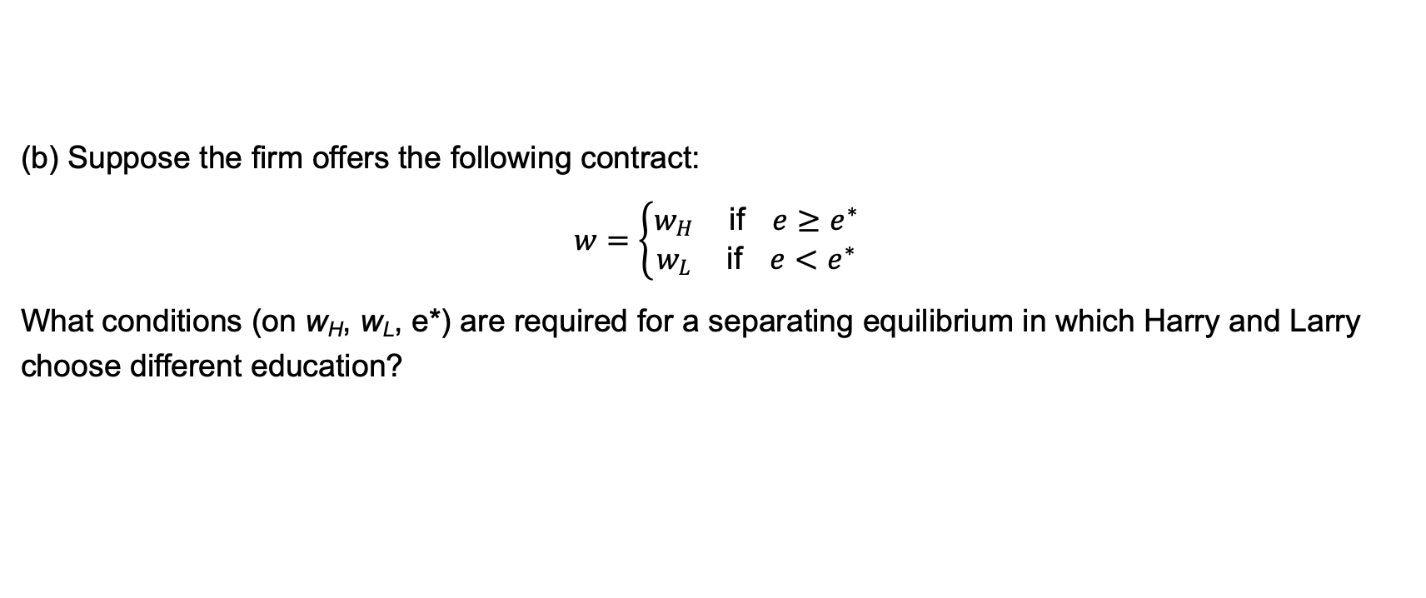
Question 2
(b) Suppose the firm offers the following contract:
$$w=\left\{\begin{matrix}w_{H} \text{if} e≥e^{∗} \\ w_{L} \text{if} e<e^{∗}\end{matrix}\right.$$
What conditions (on w_{H}, w_{L}, e*) are required for a separating equilibrium in which Harry and Larry choose different education?

Slide 12
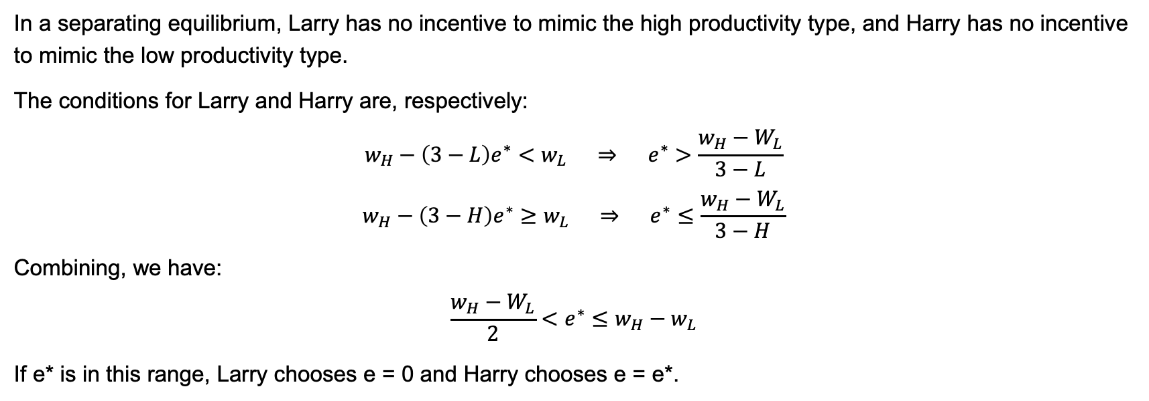
Question 2
In a separating equilibrium, Larry has no incentive to mimic the high productivity type, and Harry has no incentive to mimic the low productivity type.
The conditions for Larry and Harry are, respectively:
$$w_{H}−\left(3−L\right)e^{∗}<w_{L} ⇒ e^{∗}>\frac{w_{H}−W_{L}}{3−L}$$
$$w_{H}−\left(3−H\right)e^{∗}≥w_{L} ⇒ e^{∗}≤\frac{w_{H}−W_{L}}{3−H}$$
Combining, we have:
$$\frac{w_{H}−W_{L}}{2}<e^{∗}≤w_{H}−w_{L}$$
If e* is in this range, Larry chooses e = 0 and Harry chooses e = e*.

Slide 13
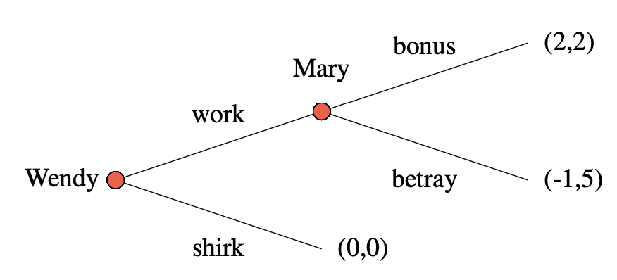
2019 Final Exam Question 1
Wendy is a worker and Mary is her manager. Mary wants Wendy to work hard, but Wendy prefers to shirk. To encourage Wendy to work hard, Mary promises to pay a bonus at the end of the month. Wendy must decide whether to work hard before knowing for sure if she will receive her bonus. They play the following sequential game. [Wendy’s payoffs are listed first]

Slide 14
2019 Final Exam Question 1
Suppose Mary and Wendy work together for one month. Solve for the subgame perfect Nash equilibrium strategies of Wendy and Mary. Explain.

Slide 15
2019 Final Exam Question 1
(a) Suppose Mary and Wendy work together for one month. Solve for the subgame perfect Nash equilibrium strategies of Wendy and Mary. Explain.

Slide 16
2019 Final Exam Question 1
Suppose Mary and Wendy work together for one month. Solve for the subgame perfect Nash equilibrium strategies of Wendy and Mary. Explain.

Slide 17
2019 Final Exam Question 1
In the sub-game perfect Nash equilibrium, Wendy’s strategy is to pick shirk, Mary’s strategy is to pick betray if Wendy picks work.

Slide 18
2019 Final Exam Question 1
(b) Mary and Wendy expect to work together for a while. Each month with probability p, they continue working together. Mary devises a system of rewards and punishments to ensure cooperation.
Consider the following trigger strategies for Wendy:
• work in period 1; work in later periods if all prior moves have been (work,bonus)
• shirk otherwise
Consider the following trigger strategies for Mary:
• bonus if Wendy chose work and if all prior moves have been (work,bonus)
• betray otherwise
Under what circumstances are these trigger strategies a subgame perfect Nash equilibrium? [7 marks]
If Mary paid a bigger bonus, would this help sustain cooperation? Explain.

Slide 19
2019 Final Exam Question 1
Solution strategy:
suppose Wendy plays her strategy
does Mary also have an incentive to play her strategy?
We have identified an SPNE if their trigger strategy is a best response for both Mary and Wendy.

Slide 20
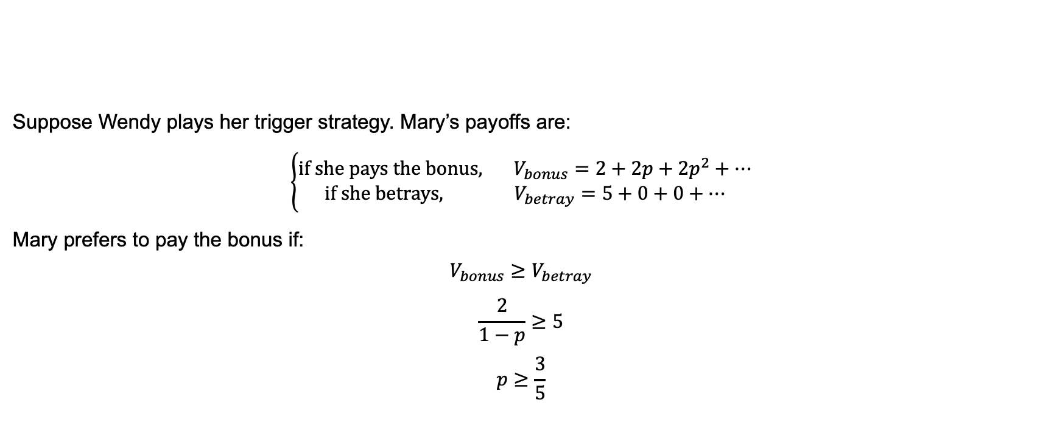
2019 Final Exam Question 1
Suppose Wendy plays her trigger strategy. Mary’s payoffs are:
$$\left\{\begin{aligned}\text{if} \text{she} \text{pays} \text{the} \text{bonus}\text{, } V_{bonus}=2+2p+2p^{2}+… \\ \text{if} \text{she} \text{betrays}\text{, } V_{betray}=5+0+0+…\end{aligned}\right.$$
Mary prefers to pay the bonus if:
$$V_{bonus}≥V_{betray}$$
$$\frac{2}{1−p}≥5$$
$$p≥\frac{3}{5}$$

Slide 21
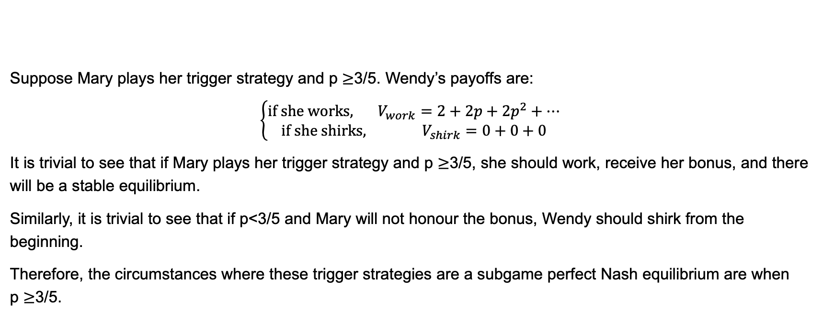
2019 Final Exam Question 1
Suppose Mary plays her trigger strategy and p $≥$3/5. Wendy’s payoffs are:
$$\left\{\begin{aligned}\text{if} \text{she} \text{works}\text{, } V_{work}=2+2p+2p^{2}+… \\ \text{if} \text{she} \text{shirks}\text{, } V_{shirk}=0+0+0\end{aligned}\right.$$
It is trivial to see that if Mary plays her trigger strategy and p $≥$3/5, she should work, receive her bonus, and there will be a stable equilibrium.
Similarly, it is trivial to see that if p<3/5 and Mary will not honour the bonus, Wendy should shirk from the beginning.
Therefore, the circumstances where these trigger strategies are a subgame perfect Nash equilibrium are when p $≥$3/5.

Slide 22
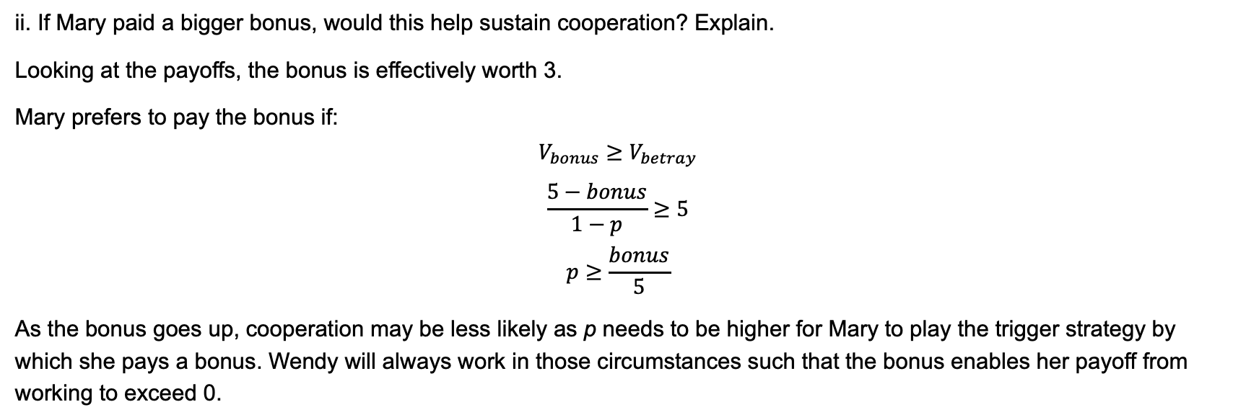
2019 Final Exam Question 1
ii. If Mary paid a bigger bonus, would this help sustain cooperation? Explain.
Looking at the payoffs, the bonus is effectively worth 3.
Mary prefers to pay the bonus if:
$$V_{bonus}≥V_{betray}$$
$$\frac{5−bonus}{1−p}≥5$$
$$p≥\frac{bonus}{5}$$
As the bonus goes up, cooperation may be less likely as p needs to be higher for Mary to play the trigger strategy by which she pays a bonus. Wendy will always work in those circumstances such that the bonus enables her payoff from working to exceed 0.

